Slide 1
Advanced Database Manipulation with Python using DuckDB
Yang Wang
PTUA 10 March 2025

Slide 2

Database and Spatial DB
Database - Data management
Collecting, storing, and using data securely and efficiently
Inform decision making
E.g ArcGIS -> file geodatabase; mobile geodatabase (SQLite)
E.g QGIS -> PostGIS (spatial extension of PostgreSQL) and SpatialLite
Spatial DB - Georeferenced spatial database
Collecting, storing and using geographic data especially in GIS
Normally relational and object-relational DB
Functions e.g. measurement, geoprocessing, geometry, etc
Spatial index to optimize spatial query by multi-dimensional ordering
BSP-tree, K-d tree, m-tree, etc
PostGIS -> R-tree

Slide 3
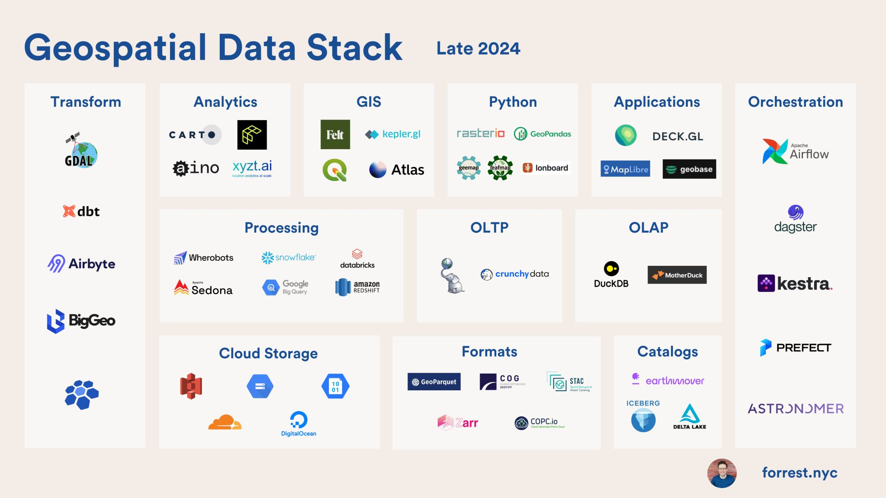
https://www.linkedin.com/posts/mbforr_gis-moderngis-geospatialdata-activity-7257443843439046656-BgOj/

Slide 4
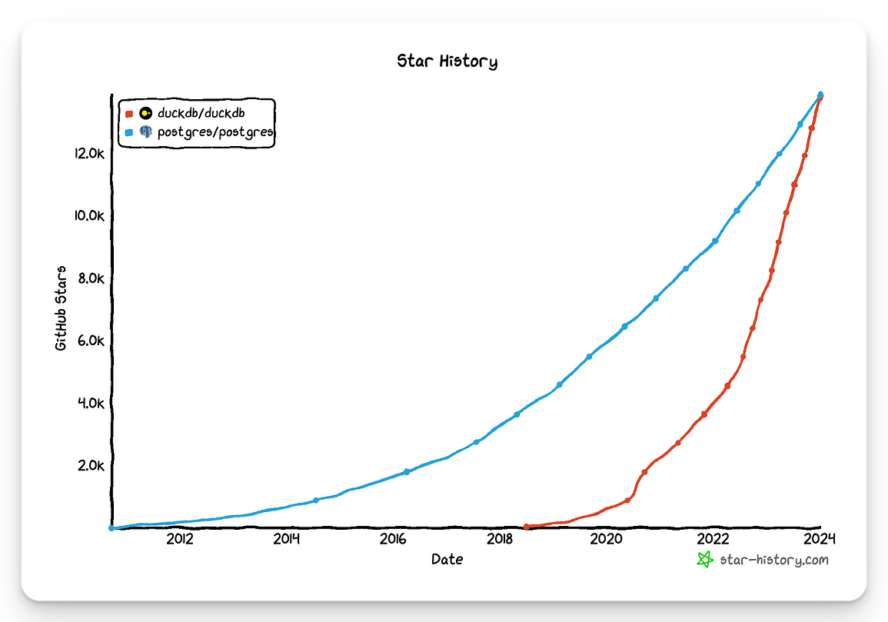

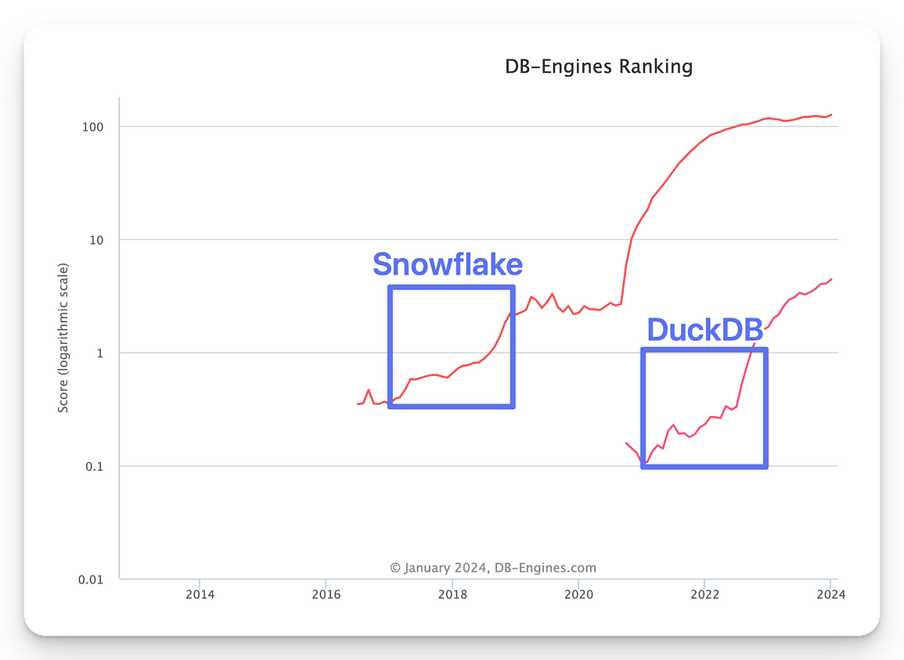
an in-process DB (that runs in the program itself, it has no independent process, resembling SQLite)
For OLAP (adjusted to analytical loads),
handles data in traditional formats (CSV, parquet),
optimized to handle large volumes of data (Parquet) using the power of a single machine (that doesn’t need to be very powerful).
https://duckdb.org/

Slide 5
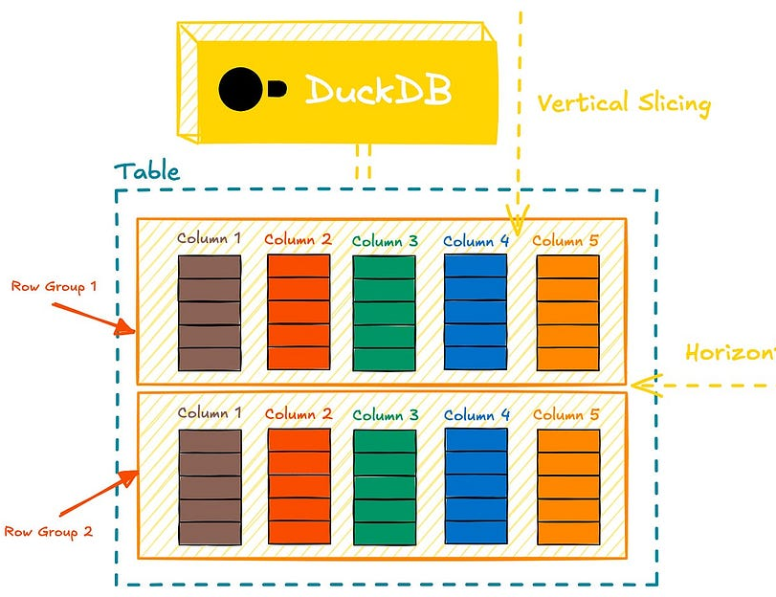
A Columnar OLAP Database
A row-columnar structure
Data is sliced into row-groups
Within each group, columns are stored separately and compressed
Similar to popular binary formats like Parquet and ORC.
https://alirezasadeghi1.medium.com/duckdb-beyond-the-hype-8b1e59360cf310

Slide 6
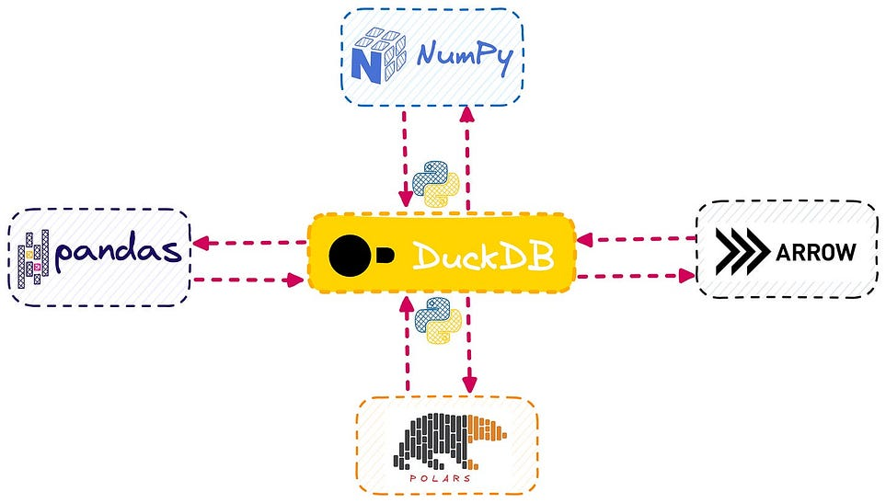
Interoperable SQL-Powered Dataframes
Integrates seamlessly with popular dataframe libraries like Pandas and Polars, allowing efficient in-memory operations
Run SQL queries directly on Python dataframes. You can query Pandas, Polars and Apache Arrow dataframe objects as though they were SQL tables.
Some frameworks such as Apache Arrow, DuckDB uses zero-copy mode for fast conversion
https://alirezasadeghi1.medium.com/duckdb-beyond-the-hype-8b1e59360cf310

Slide 7
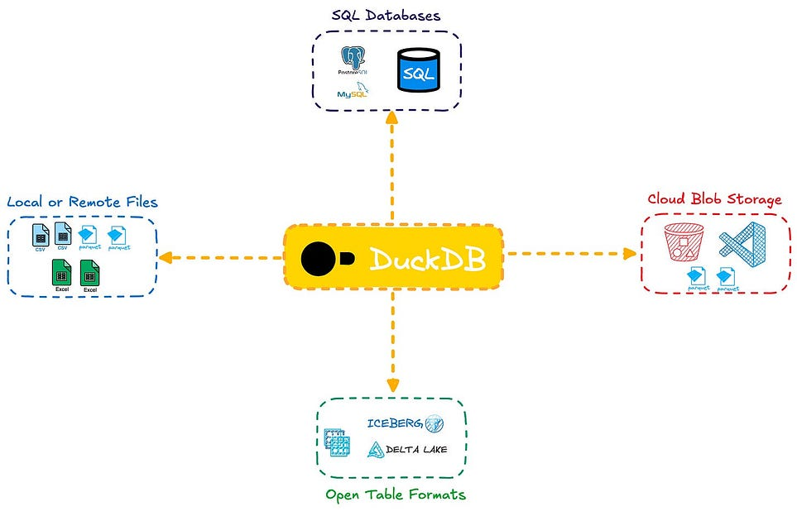
A Federated Query Engine
Efficient way to query external data systems through its extensions.
Directly query DBMS systems like MySQL and Postgres, open data files like JSON, CSV, and Parquet files stored in cloud storage systems like Amazon S3, and modern open table formats like Apache Iceberg and Delta Lake.
Create persistent Views over the external tables or data files, like a read-only external table.
https://alirezasadeghi1.medium.com/duckdb-beyond-the-hype-8b1e59360cf310

Slide 8
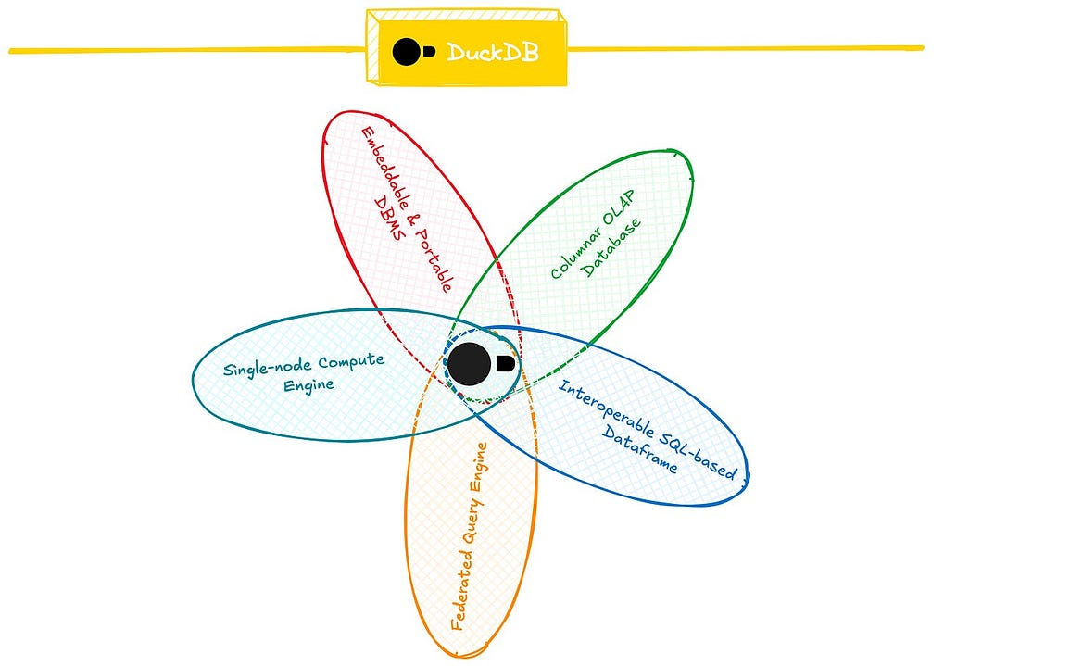
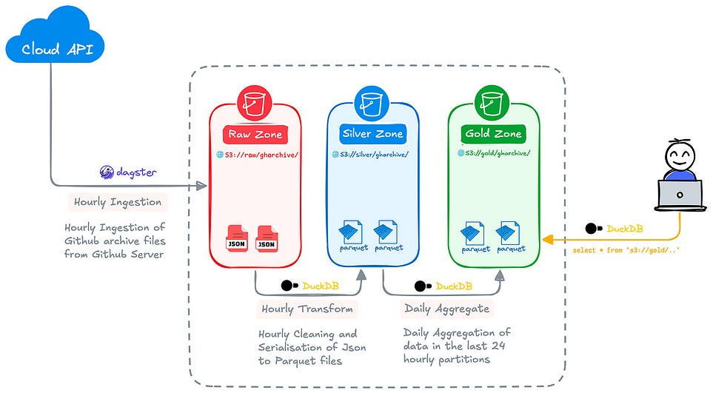
A Single-Node Compute Engine
Perform ephemeral batch transformations.
Efficiently serialise raw data (e.g., JSON or CSV) into optimised formats like Parquet, and then transform or aggregate that data.
E.g. aggregate 100M rows in 1min
https://alirezasadeghi1.medium.com/duckdb-beyond-the-hype-8b1e59360cf310

Slide 9
DuckDB – spatial extension
Benifit
operate, transform and join your geospatial data alongside your regular, unstructured or time-series data using DuckDBs rich type system and extensions like JSON
spatial queries involving geometric predicates and relations translate surprisingly well to SQL, which is all about expressing relations after all!
all the other benefits provided by DuckDB such as transactional semantics, high performance multi-threaded vectorized execution and larger-than-memory data processing.
What in it?
Similar to database systems such as PostGIS or SpatiaLite.
geospatial libraries, GEOS, GDAL and PROJ, which provide algorithms, format conversions and coordinate reference system transformations respectively
leverage GDAL to provide a set of table and copy functions that enable import and export of tables from and to 50+ different geospatial data formats (so far!), including the most common ones such as Shapefiles, GeoJSON, GeoPackage, KML, GML, WKT, WKB, etc.
Not yet super mature
leveraging a lot of great open source software, e.g. GEOS, which is the same spatial engine that PostGIS uses
leveraged to great effect was OGR/GDAL. You can easily import or export any format that OGR supports
not ready to commit to full compliance with the OGC Simple Feature Access
https://medium.com/radiant-earth-insights/duckdb-the-indispensable-geospatial-tool-you-didnt-know-you-were-missing-5fe11c5633e5

Slide 10
Overall benefit for us
‘The geospatial world need to meet people more than halfway, enabling them to stay in their existing workflows and toolsets.’
---Chris Holmes (Product Architect @ Planet, Board Member @ Open Geospatial Consortium, Technical Fellow @ Radiant.Earth)
https://medium.com/radiant-earth-insights/duckdb-the-indispensable-geospatial-tool-you-didnt-know-you-were-missing-5fe11c5633e5

Slide 11
Useful resources
Official site
https://duckdb.org/
https://duckdb.org/docs/
Official training site
https://motherduck.com/
https://motherduck.com/duckdb-book-brief
Open Geospatial Solutions https://geog-414.gishub.org/
https://geog-414.gishub.org/book/duckdb/01_duckdb_intro.html
Open Geospatial Solutions youtube channel
https://youtu.be/A4TOAdsXsEs?si=SUiBe3FHSijIMyRK
awesome DuckDB
https://github.com/davidgasquez/awesome-duckdb
Peer-Reviewed Papers and Thesis Works
Runtime-Extensible Parsers (CIDR 2025)
Robust External Hash Aggregation in the Solid State Age (ICDE 2024)
These Rows Are Made for Sorting and That's Just What We'll Do (ICDE 2023)
Join Order Optimization with (Almost) No Statistics (Master thesis, 2022)
DuckDB-Wasm: Fast Analytical Processing for the Web (VLDB 2022 Demo)
Data Management for Data Science - Towards Embedded Analytics (CIDR 2020)
DuckDB: an Embeddable Analytical Database (SIGMOD 2019 Demo)
https://duckdb.org/why_duckdb

Slide 12
Reference
https://alirezasadeghi1.medium.com/duckdb-beyond-the-hype-8b1e59360cf3
https://mihaibojin.medium.com/duckdb-the-big-data-rising-star-71916f953f18
https://medium.com/radiant-earth-insights/duckdb-the-indispensable-geospatial-tool-you-didnt-know-you-were-missing-5fe11c5633e5

